Slide 1
COVID-19 Data Analysis & Dashboard Visualization
Objective:
Analyze global COVID-19 data using Python and visualize insights using Power BI to understand the pandemic’s impact across countries.
GitHub:-
https://github.com/AlekhyaC2005/GUVI_HCL_Project1

Slide 2
Dataset Overview
Dataset: full_grouped.csv
Source: Kaggle
Columns: Country, Date, Confirmed, Deaths, Recovered, Active, etc.
Period: Covers data from early 2020 to mid-2021
CODE:
df = pd.read_csv("full_grouped.csv")
dfcovid = df.drop(columns=['Confirmed', 'New deaths', 'New recovered', 'WHO Region'])
covid = dfcovid.rename(columns={'Country/Region': 'country'})

Slide 3
Data Cleaning & Exploration
Steps Performed:
Dropped unnecessary columns
Renamed key fields (Country/Region → country)
Checked for nulls and duplicates
covid.isnull().sum()
covid.duplicated().sum()
covid.describe()

Slide 4
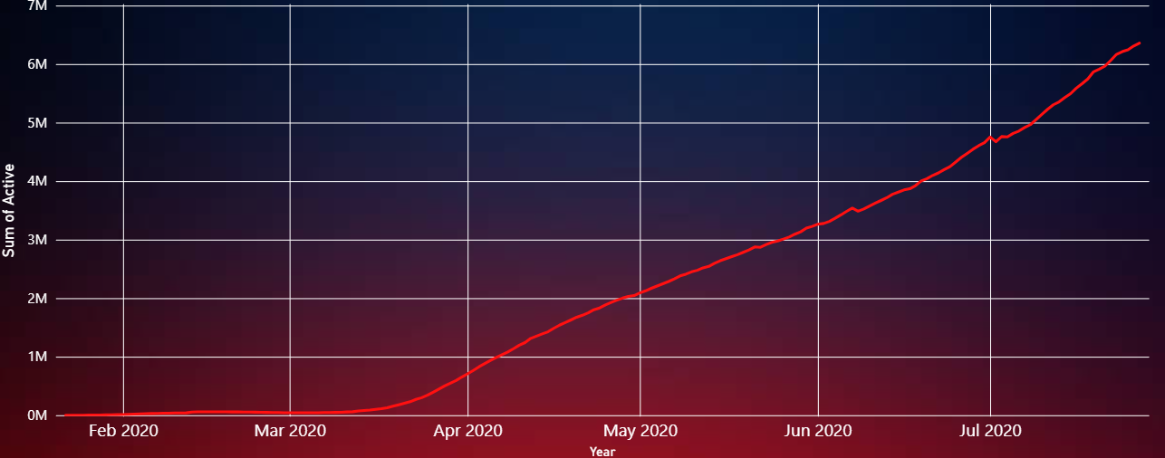
Trend of Active Cases Over Time
Insight:
Clear upward trend in active cases globally from Jan to July 2020
Data used to understand pandemic progression
Corresponding Power BI Chart: 📊 "Active by Year, Month and Day" (Top Line Graph)

Slide 5
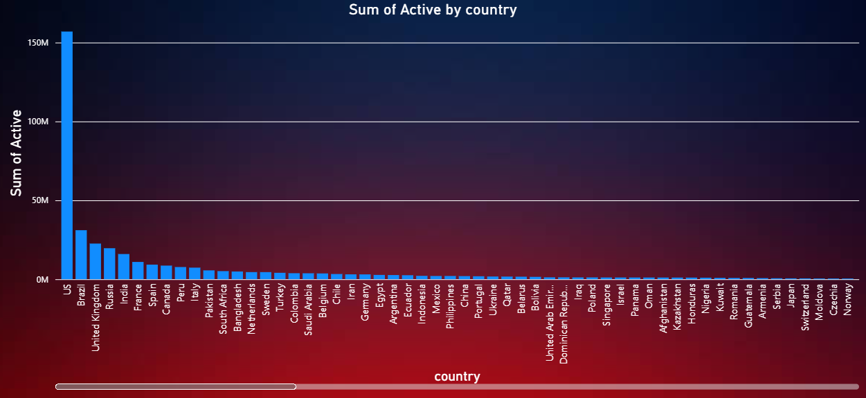
Top 30 Countries by Active Cases
Insight:
US, Brazil, UK, Russia, India top the list
Helps identify heavily impacted regions
Corresponding Power BI Chart: 📊 "Sum of Active by Country" (Bottom Right Bar Chart)

Slide 6
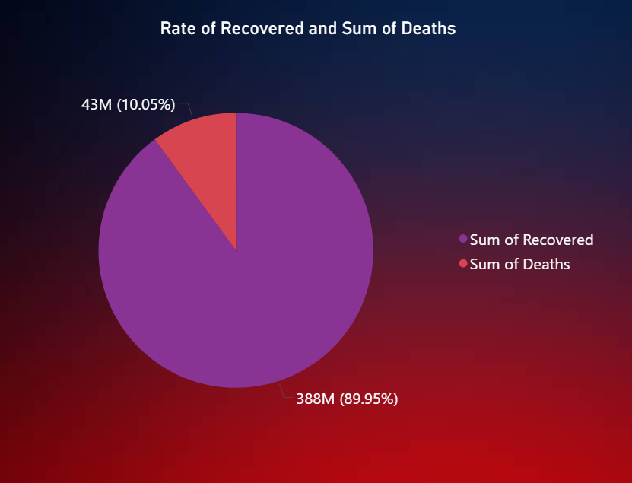
Recovery vs Death Rate
Corresponding Power BI Chart: 🥧 "Rate of Recovered and Sum of Deaths" (Bottom Left Pie Chart)

Slide 7
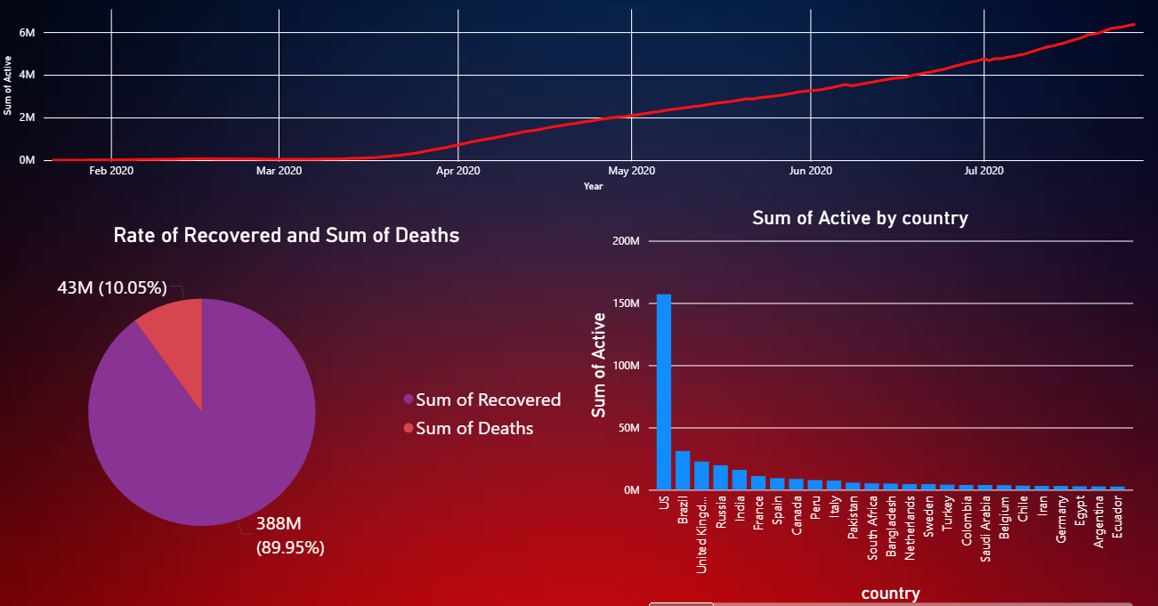
Key Insights & Takeaways
US and Brazil had the highest number of active cases in early 2020
Recovery rate was significantly higher than the death rate
Power BI provided intuitive ways to visualize complex trends
Combined data engineering and business intelligence skills

